Slide 1
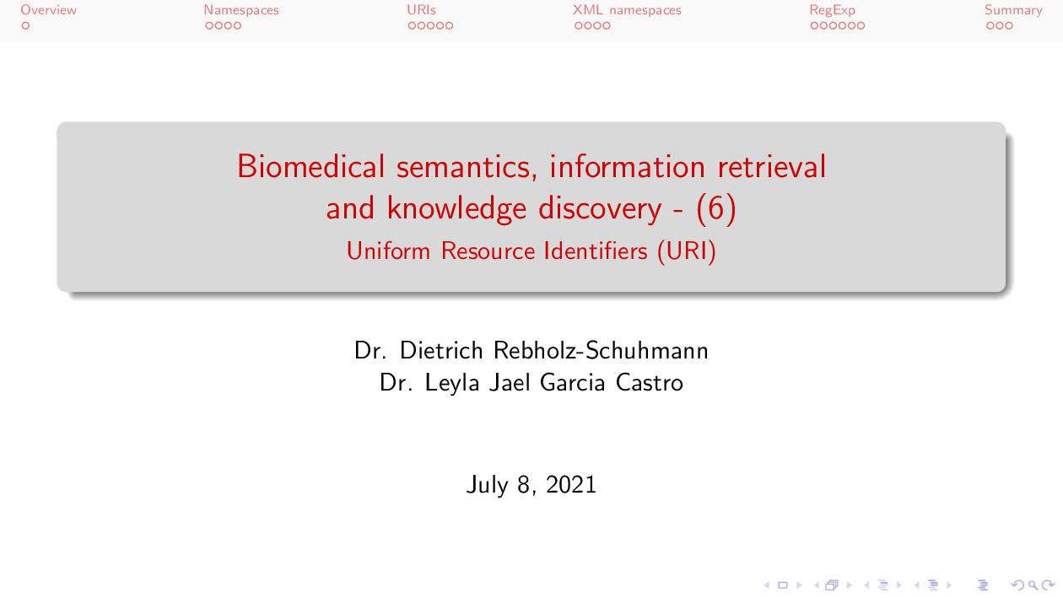

July, 2021

Slide 2
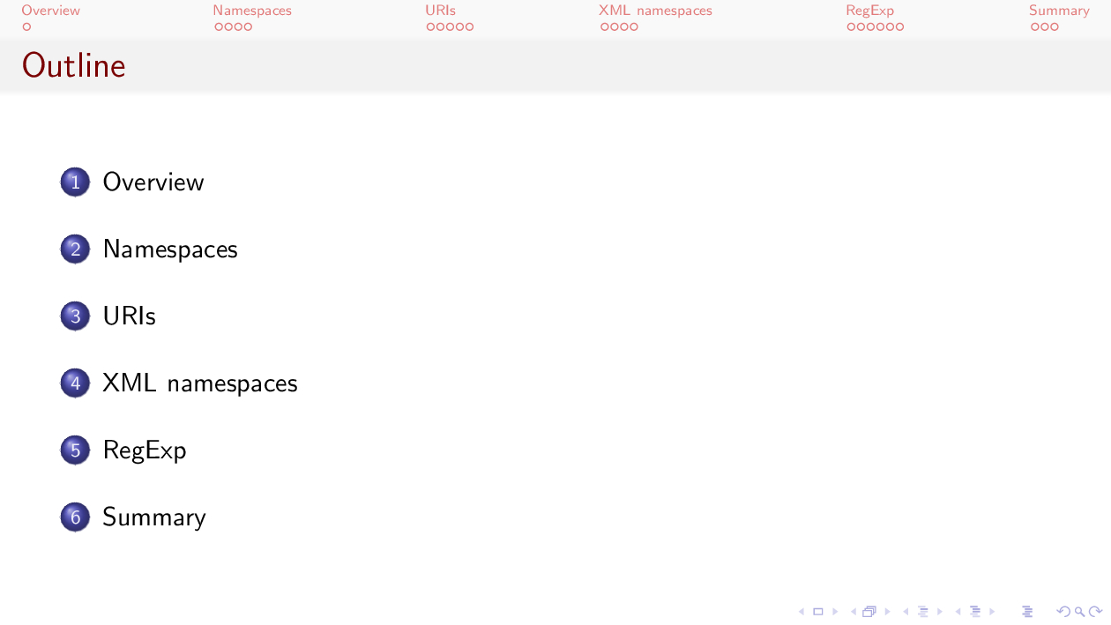

Slide 3
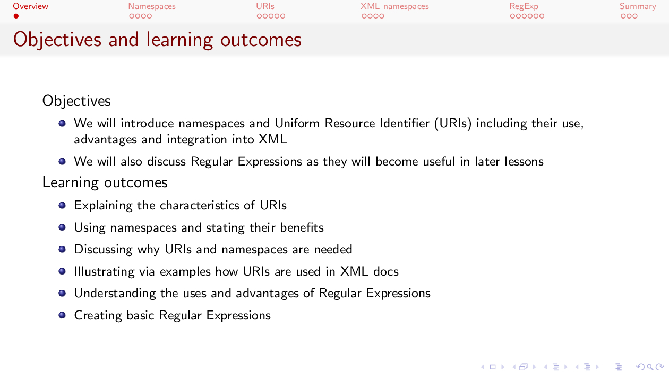

Slide 4


Slide 5
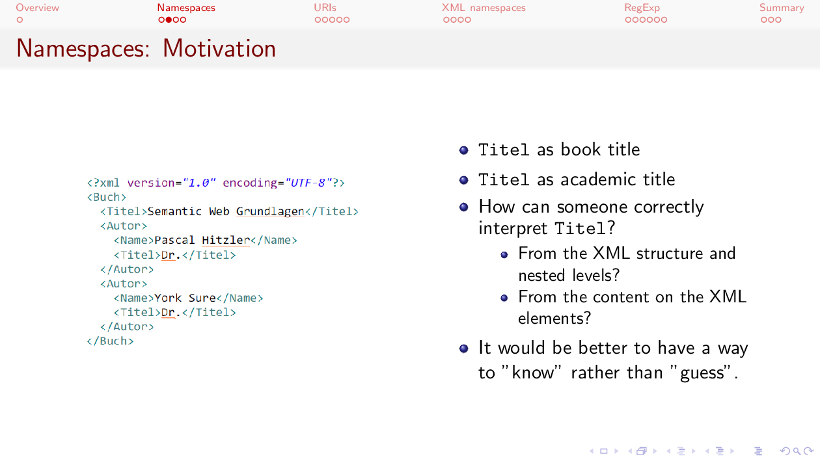

Slide 6
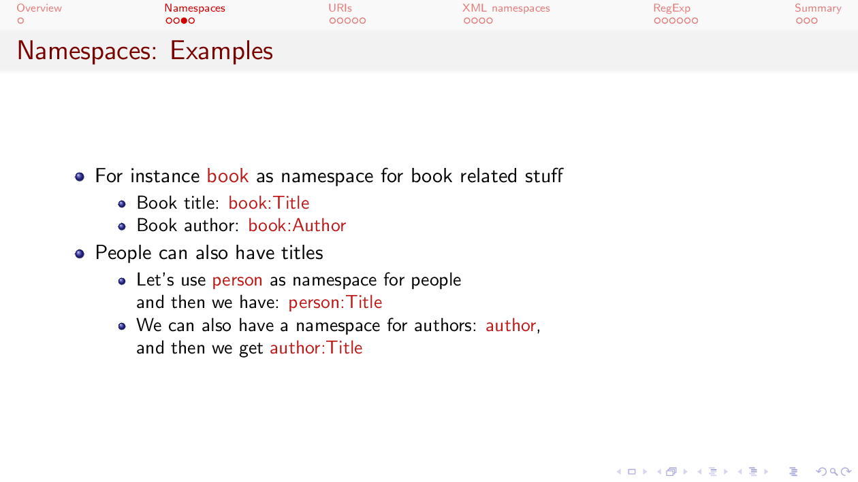

Slide 7
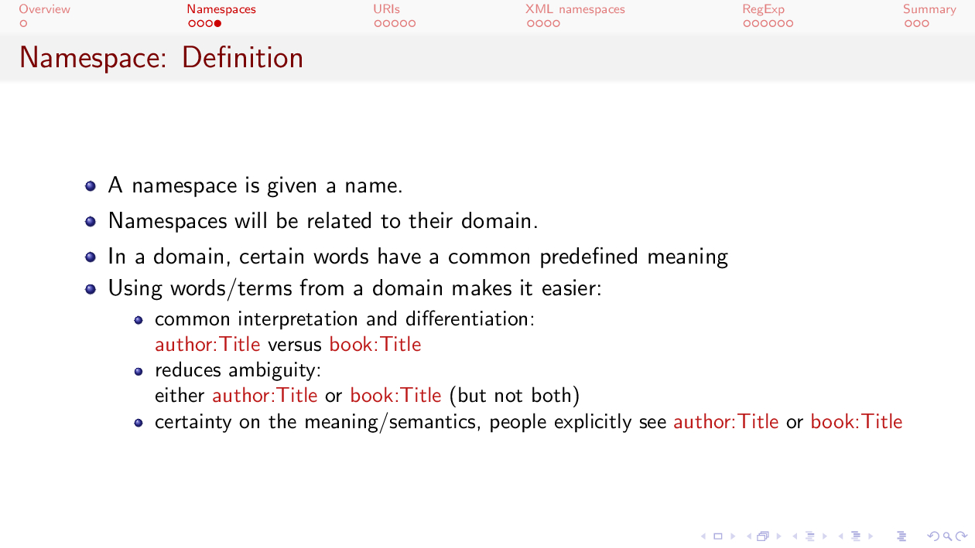

Slide 8
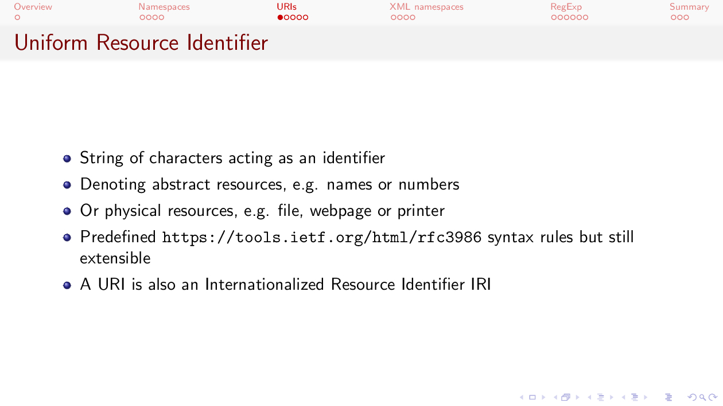

Slide 9
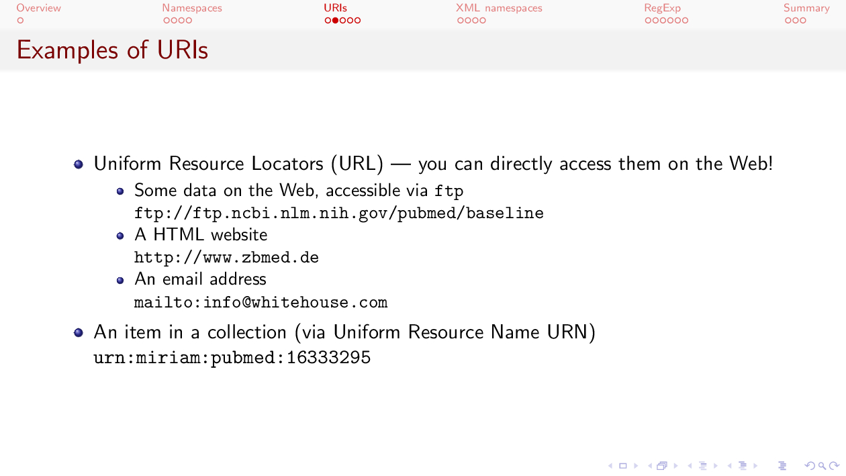

Slide 10
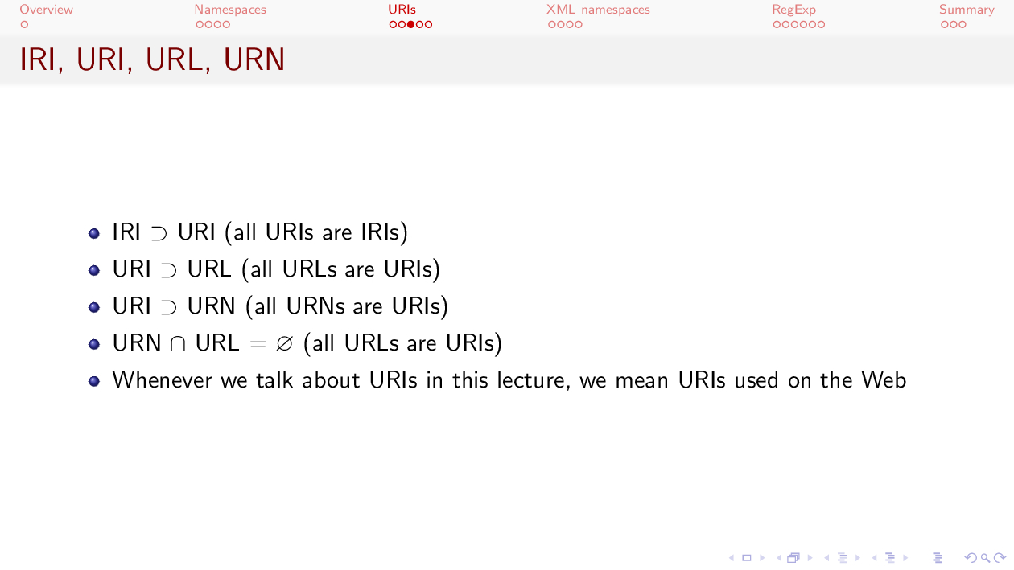

Slide 11
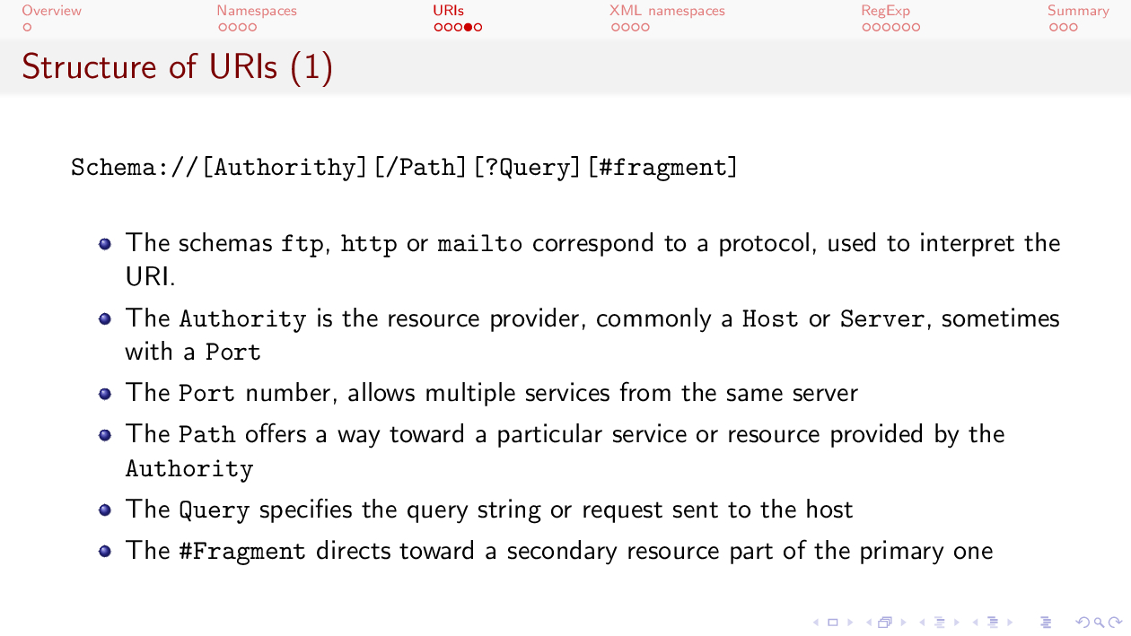

Slide 12
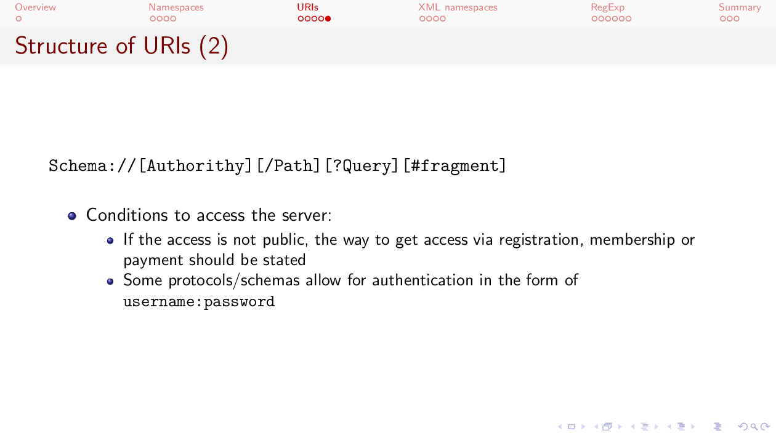

Slide 13
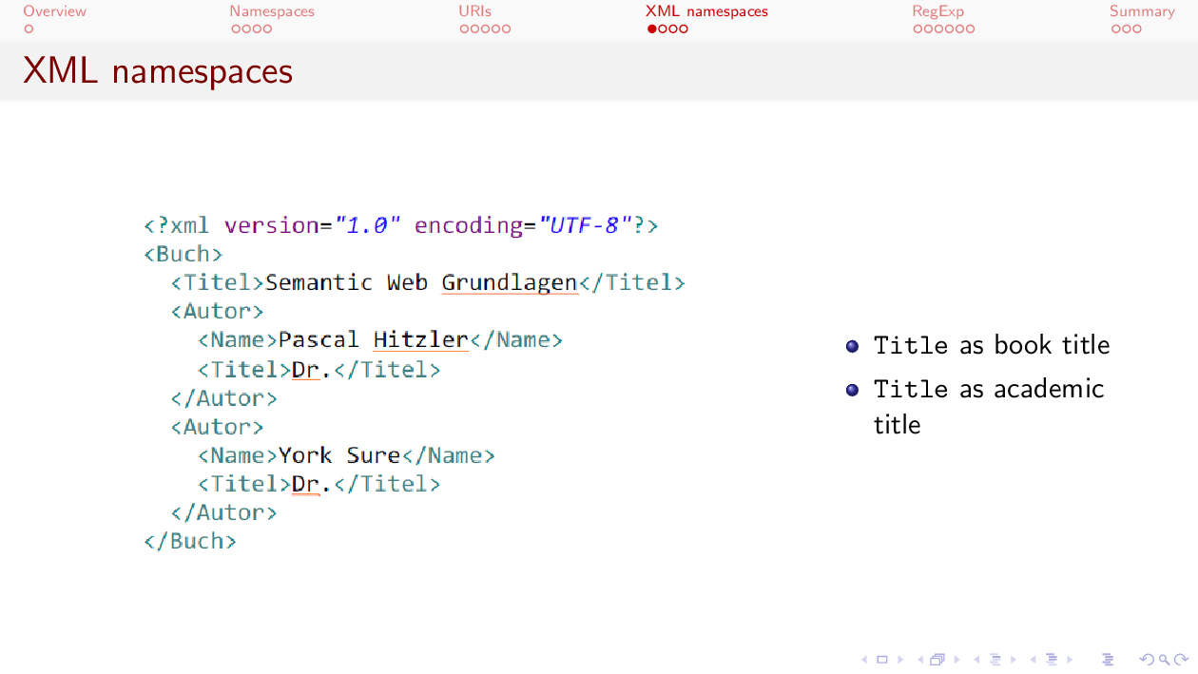

Slide 14
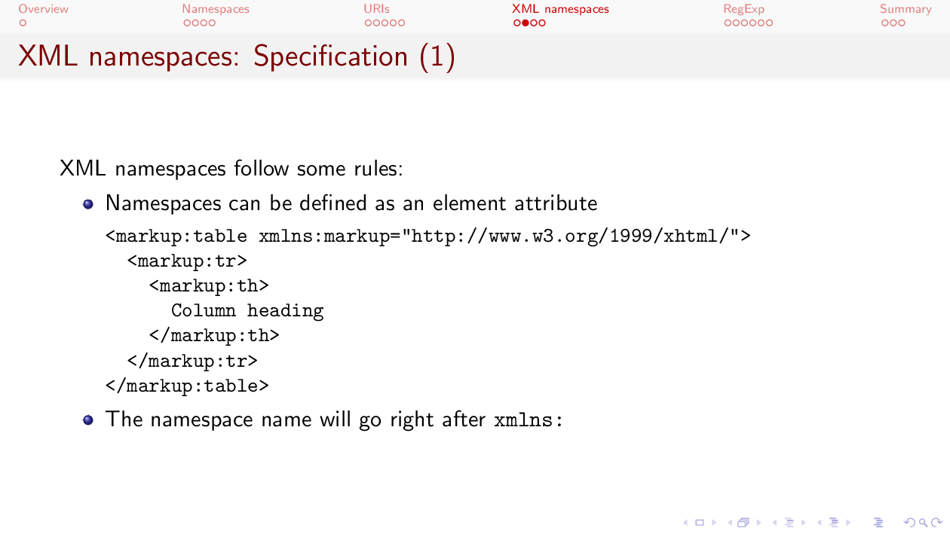

Slide 15
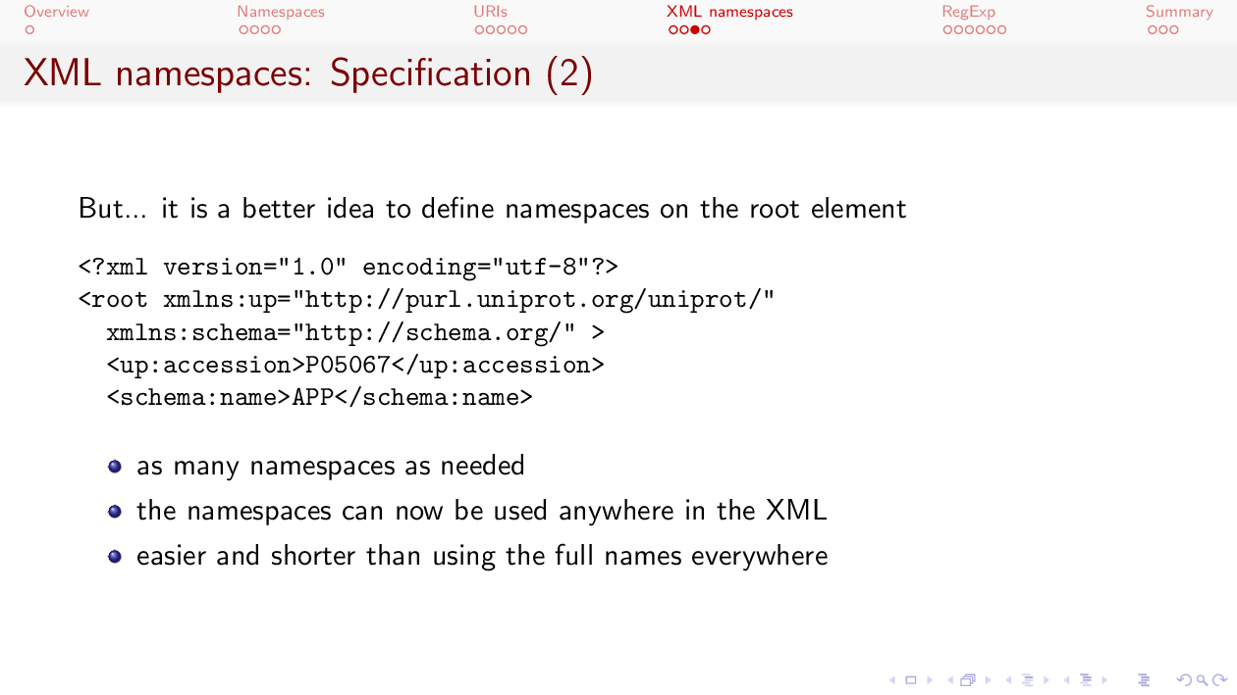

Slide 16
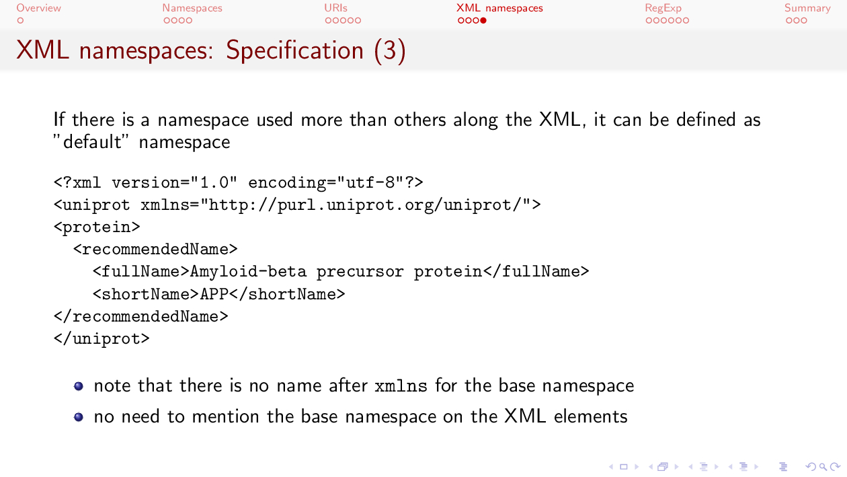

Slide 17


Slide 18
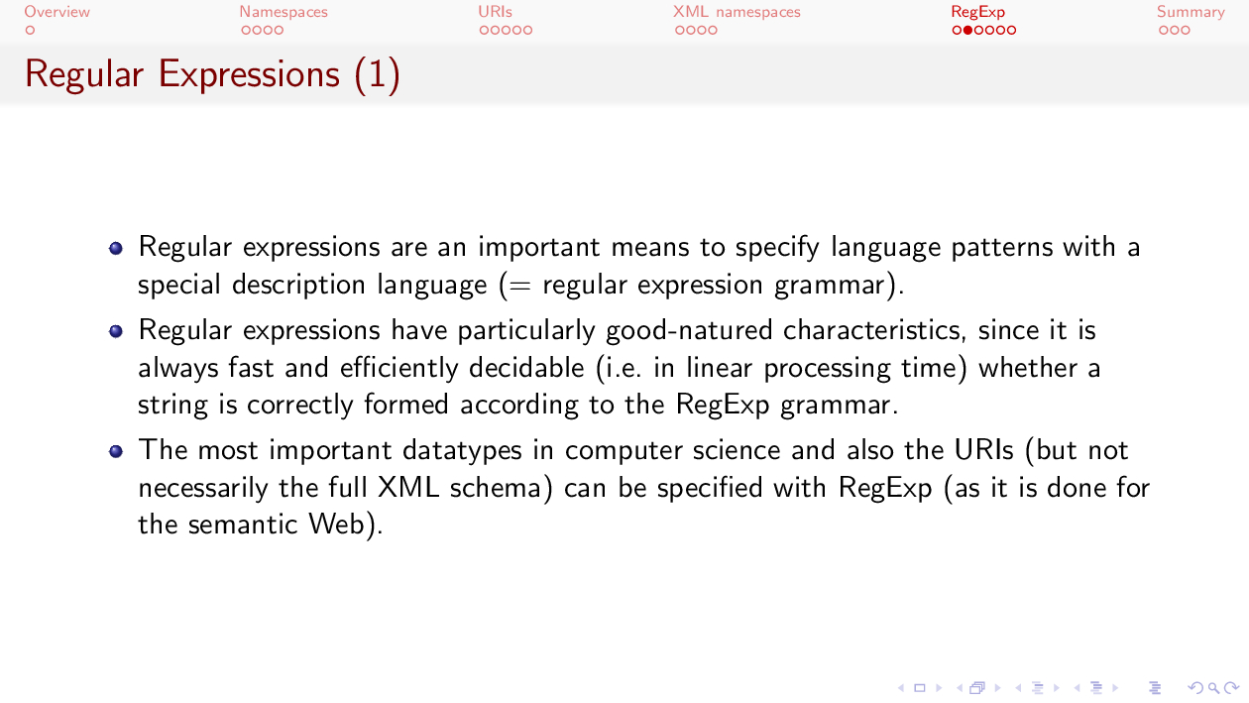

Slide 19
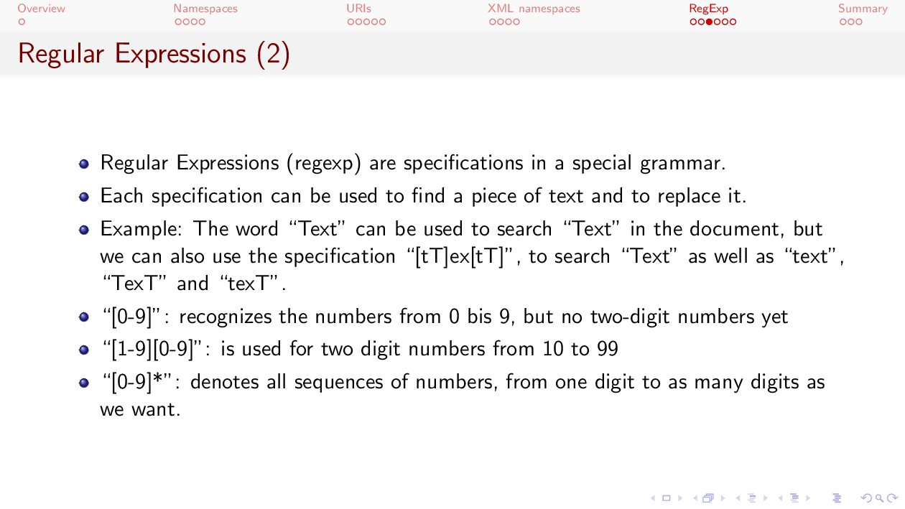
to

Slide 20
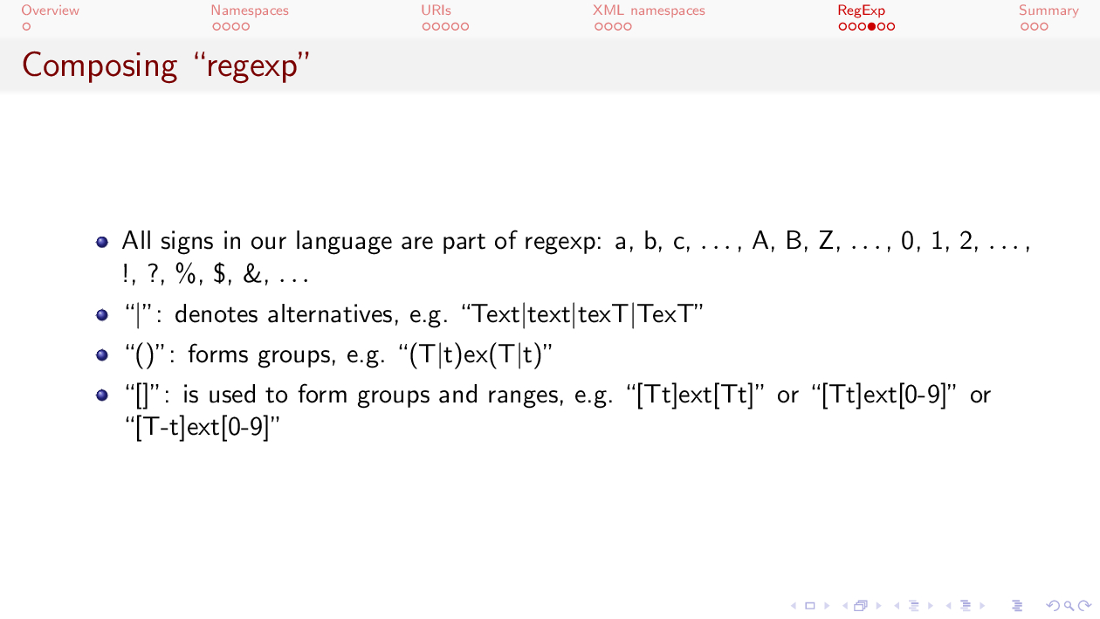
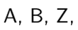
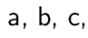
Notes:
We can also combined regular expressions all together in order to get a composition of them. This will give us the chance to express more complex regular expressions.
As part of our regular expressions, we can use any character, any letter in lower case, any letter in upper case, all numbers and a lot of other symbols as we can see here.
All of these symbols will be assigned a number. For instance the letter A in upper case has been assigned the number 65 while B upper case corresponds to number 66. a lower case is number 97
We will also have some special characters or elements in a regular expression that will have a special meaning as defined by the syntax of regular expressions.
For instance, the pipe character denotes alternatives. In here, we are saying we want to find a the word text with the first T capitalized or all in lower case or the last T capitalized or both Ts capitalized.
In any of these cases, in any of this alternatives, we are saying that the portion corresponding to ex is always expected in lower case.
We can also create groups by using parenthesis. Anything within a pair of parenthesis will be one group.
Here we are saying that we are expecting a first group with a T capitalized or not, then we want ex and then another T again capitalized or not
Notice here how we can combine small regular expressions to get a more complex one.
We can also use square brackets to denote ranges. As we have seen already, we can use these brackets for digits from 0 to 9, in that case we use a dash between the 0 and the 9
If we list all the options, as we do here T capital or t regular, it works in a similar way as using a pipe to denote alternatives.
If we use T upper case to t lower case, we are including all symbols between these two characters, for instance T U V upper case and later on also a, b, c lower case all the way to t lower case.
Regular expressions, as we mentioned at the beginning, are very powerful. In the Biomedical domain, you could use them, for instance, to find out protein with sequences with,
let’s say any hydrophobic amino acid (alanine liucine and so) followed by an aromatic one (tyrosine for instance)

Slide 21
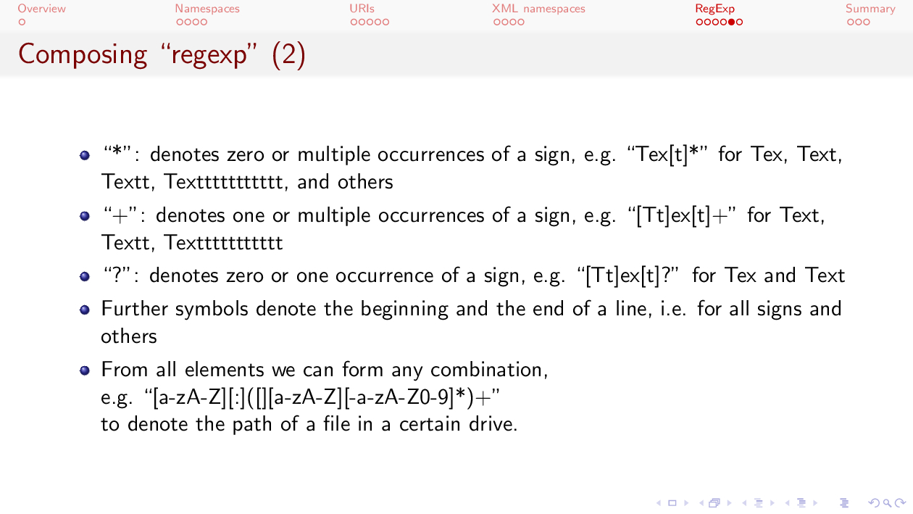

Slide 22
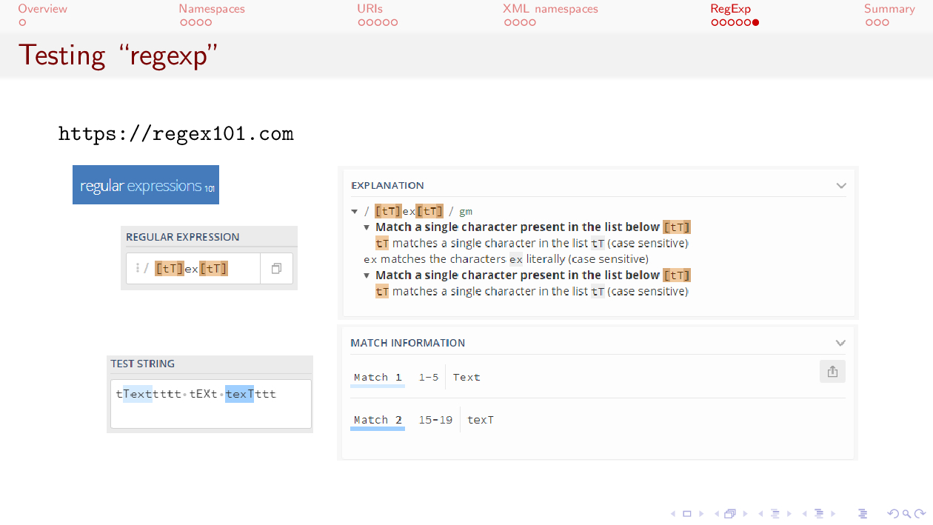
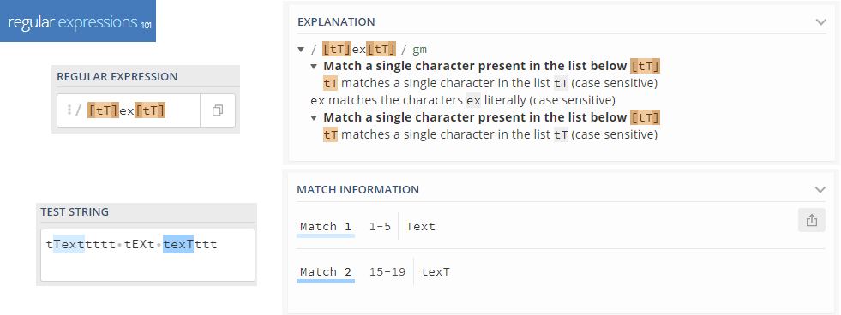
Notes:
There are a lot of tools out there on Internet that will help you try and test regular expressions.
Here I am including one that I came up with the other day. I liked its interface and the explanatory notes on the side.
Here we have a regular expression that can identify pieces of text starting with any symbol between T upper case and t lower case
We can see on the explanatory note that it means any symbol corresponding to a number between 84 and 116
After it, we expect the characters ex
And then one t, either upper or lower case.
Tools to try and test regular expressions will also allow you to add some text and see what matches the regular expression as we can see here in the Test String area.
As I said, this is one drop in an ocean. There are many more tools out there.
You search, pick one and try it out.

Slide 23


Slide 24
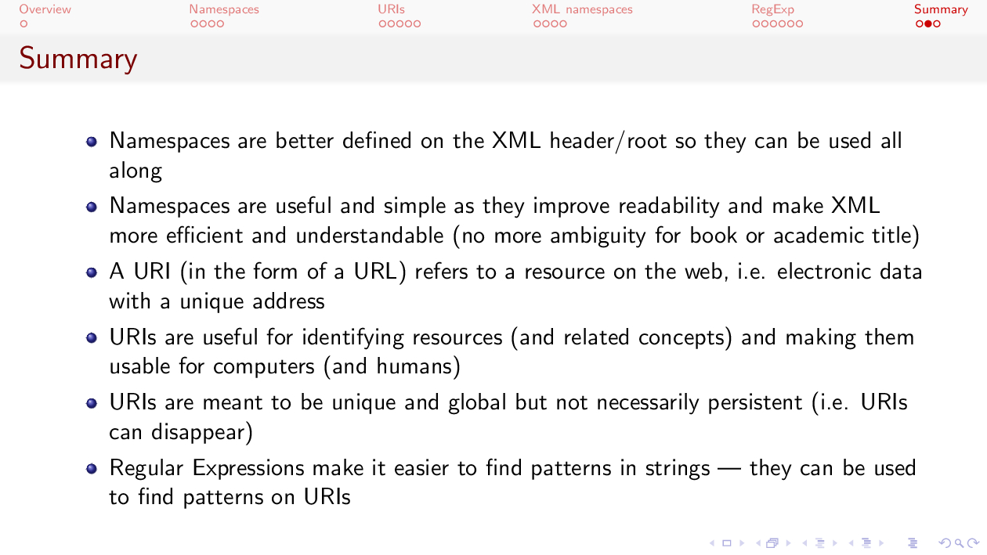

Slide 25
